Slide 1
ESTIMATE_POSE_RANSAC.PY output
Pages 2-3: Derivation
Page 4: Plots for 0 iteration Ransac
Page 5: Plots for 10 iteration Ransac
Page 6: Observations
Ikenna Achilihu
MEAM 620, Spring 2021
Project II phase 1I

Slide 4
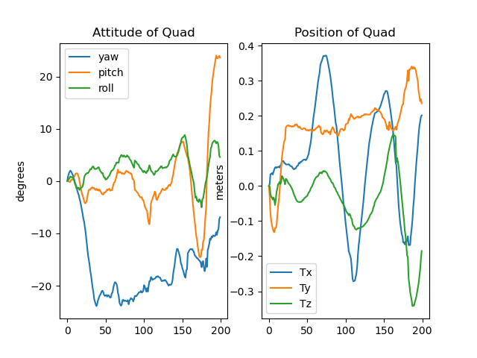
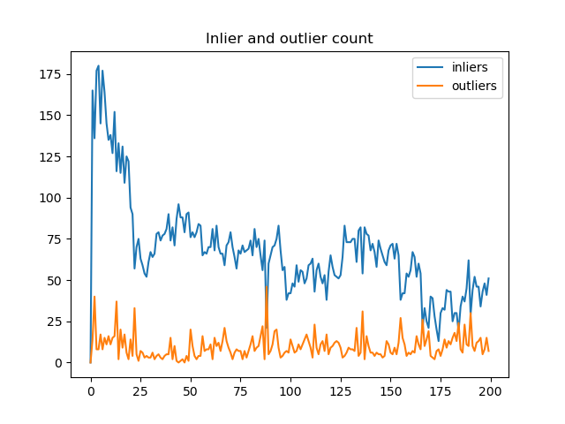
Ransac Iterations = 10
Ransac Iterations = 10

Slide 5
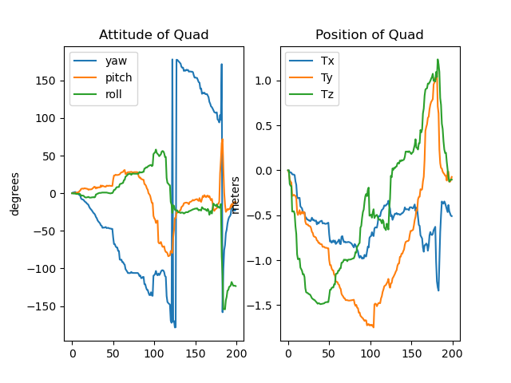
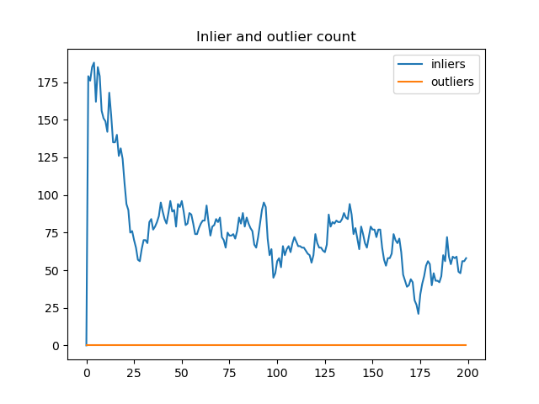
Ransac Iterations = 0
Ransac Iterations = 0

Slide 6
We see that when we use 10 iterations, the position and attitude plots are smooth and continuous. Furthermore, since we are being more stringent in our criteria for outliers, this is represented in the inlier/outlier plot. For 0 iterations, since we treat all correspondence points as inliers, even though they may in fact be outliers, we don’t see as smooth position and attitude plots.

